Slide 1




KINGDOM OF SAUDI ARABIA Ministry of Higher Education Taibah University College of Computer Science and Engineering (Girls Section)
E-help Platform for Voluntary and Humanitarian Aid
Prepared by: Raghad Mirza 3750410 Razan Jaad 3757541 Goot Aljuhani 3750224 Nada Almuzini 3751365
Supervised by: Ms. Ebtehal Assery

Slide 2








Table of Contents
- Functional Requirements Results
- Non-Functional Requirements Results
System Analysis
Result and Discussion
Main Code
Future Work
Language and Tools
Introduction
System Testing
Conclusion
- Problem definition - Project Objectives
1

Slide 3


Introduction
Our Religion
Volunteering is one of the sources of good as it is an important cultured and human behavior
Vision 2030
2

Slide 4
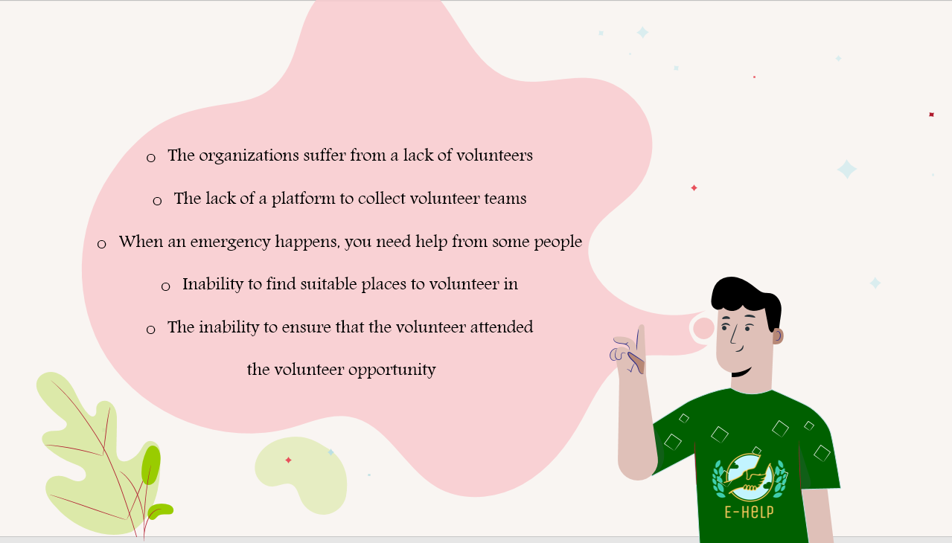
Problem Definition
3

Slide 5




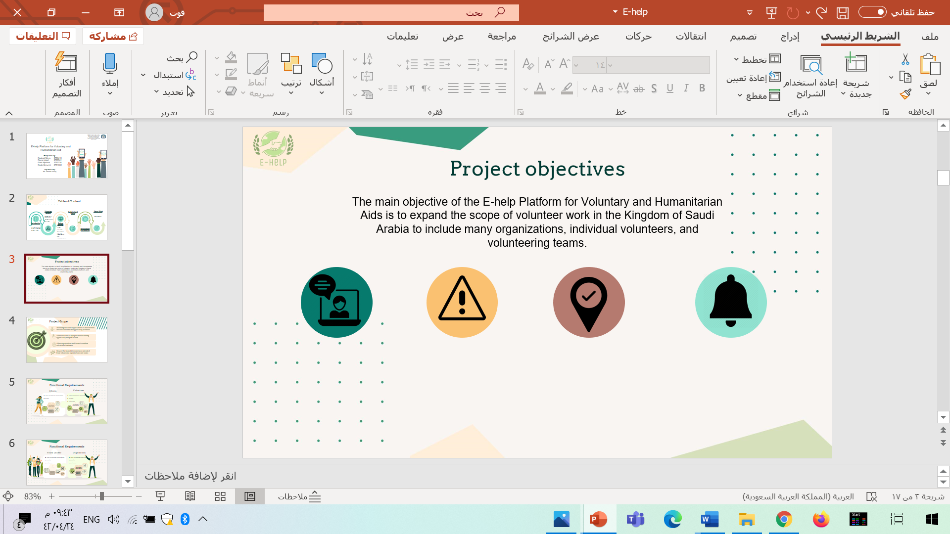
Project Objectives
The main objective of the E-help Platform for Voluntary and Humanitarian Aids is to expand the scope of volunteer work in the Kingdom of Saudi Arabia to include many organizations, individual volunteers, and volunteering teams.
Volunteer opportunity
Immediate assistance
Check-in
Virtual volunteering
To display all volunteer work by organizations and teams on the platform.
Provides immediate assistance for emergency cases.
To ensure that the volunteer will attend the event the e-help platform provides a check-in feature.
To provides virtual volunteering for people who search for volunteer opportunities they can complete via a home.
.
4

Slide 6
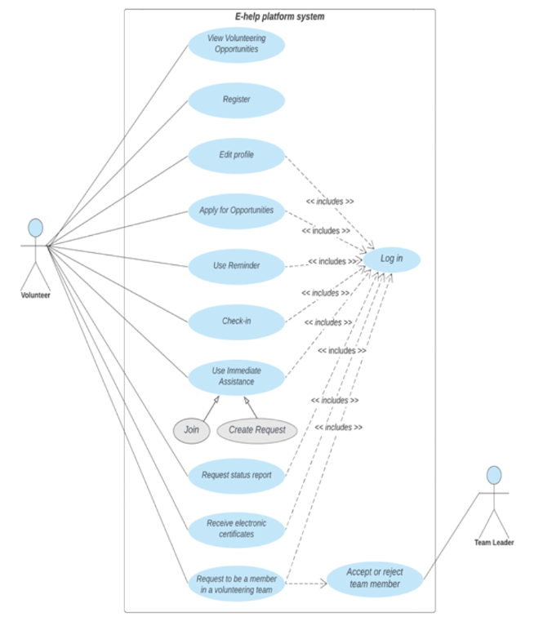

System Analysis
Use case
Volunteer
5

Slide 7
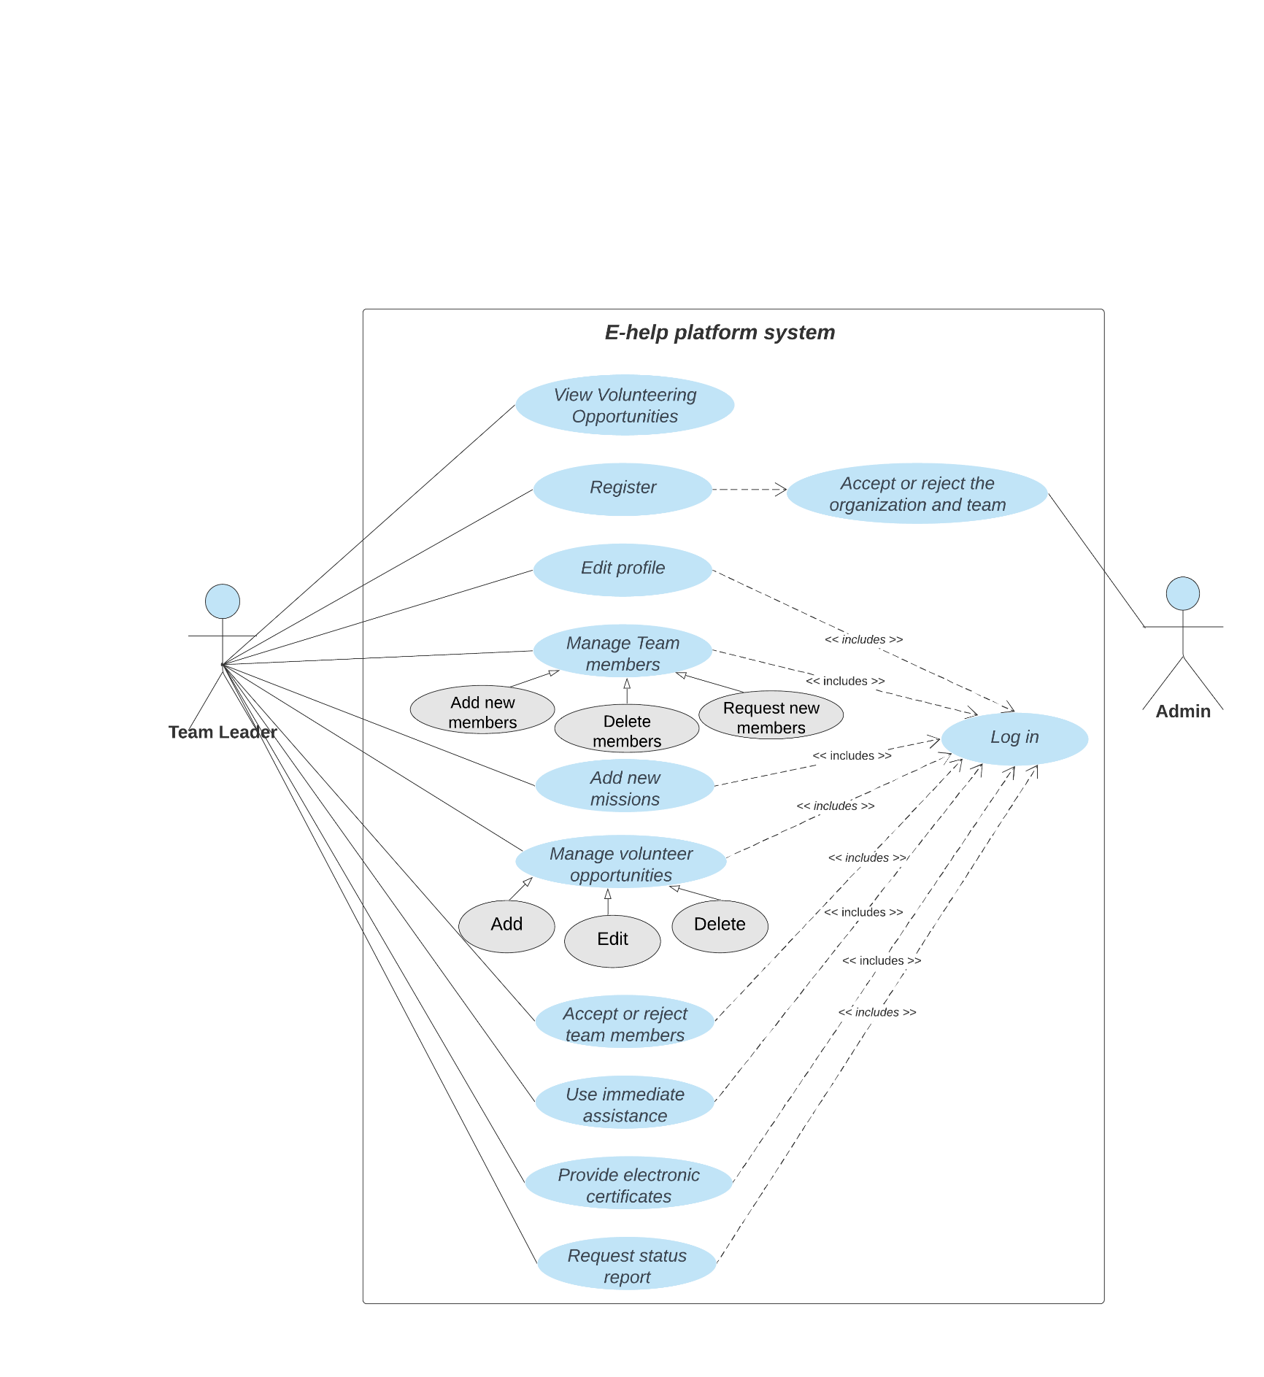

System Analysis
Use case
Team Leader
6

Slide 8
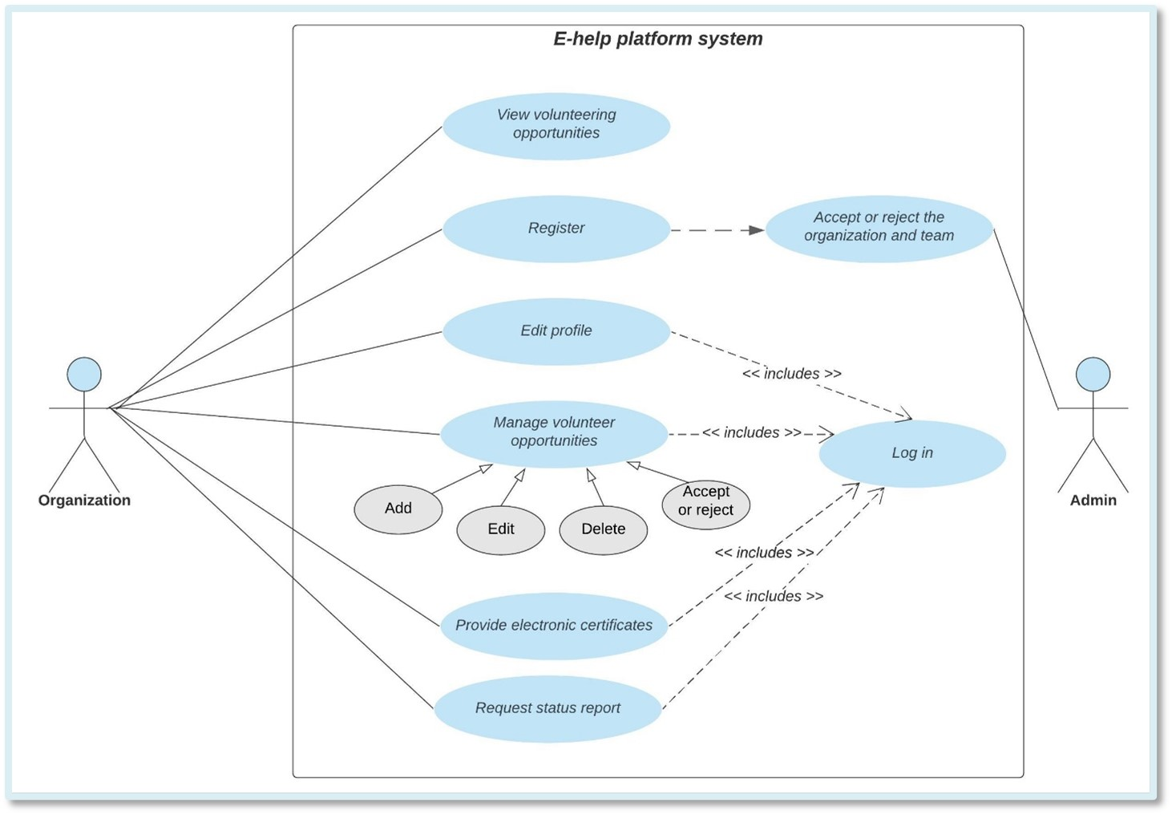

System Analysis
Use case
Organization
7

Slide 9
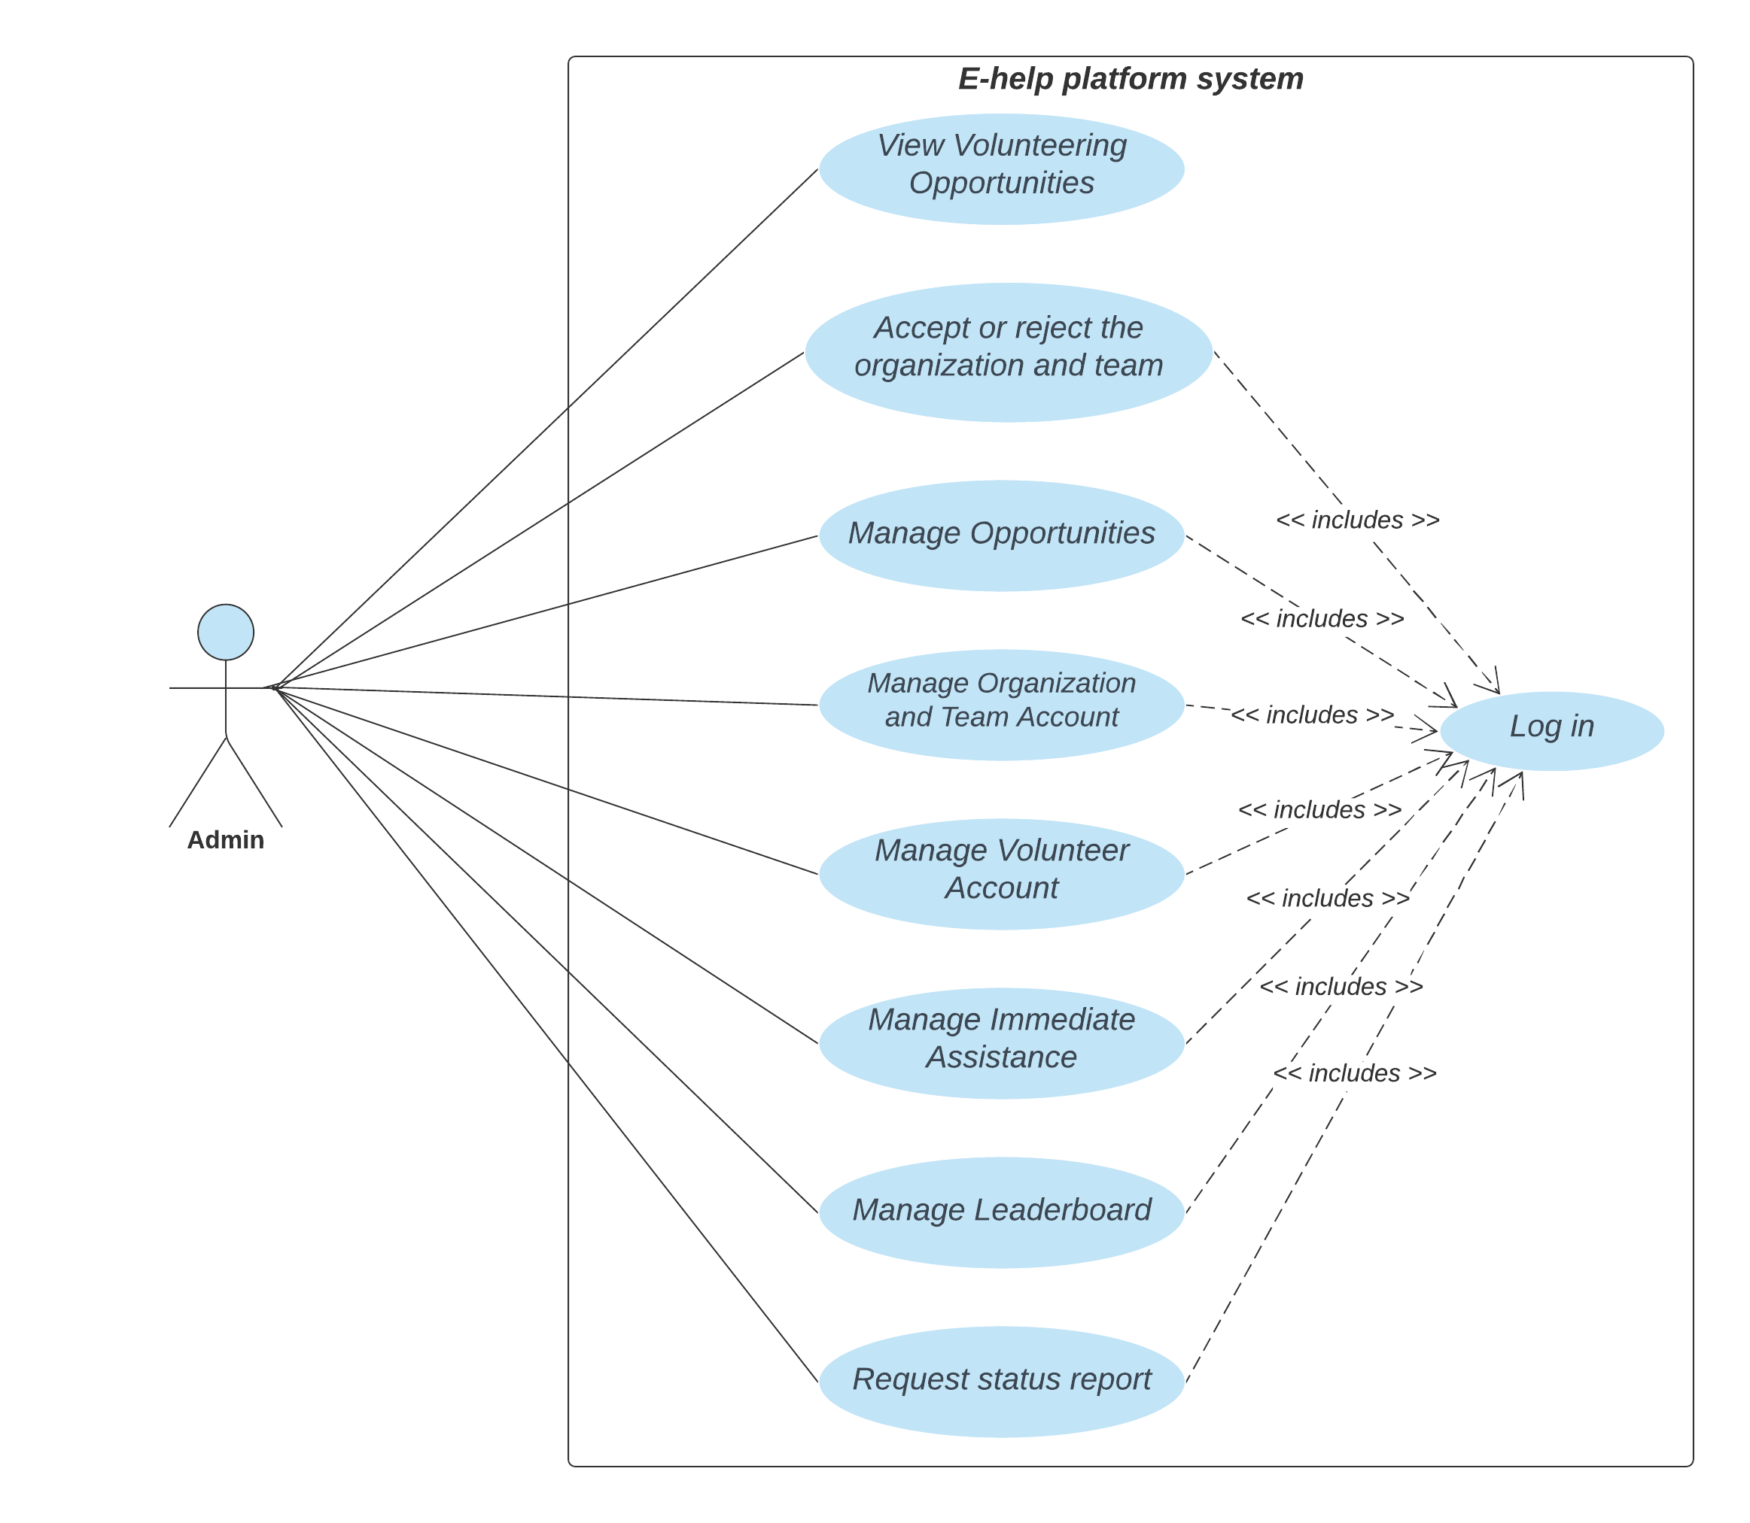

System Analysis
Use case
Admin
8

Slide 10





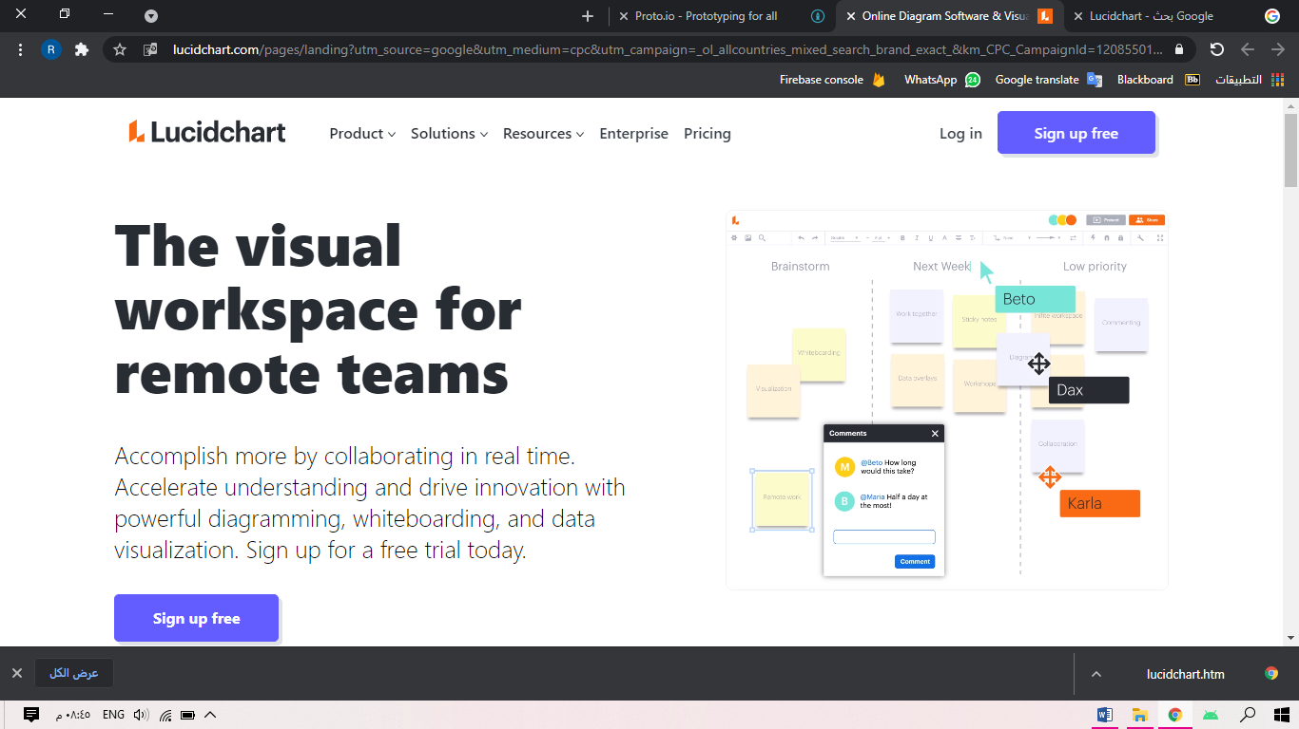




Language and Tools
Language and Tools
Android Studio
Word Microsoft
PowerPoint Microsoft
9

Slide 11
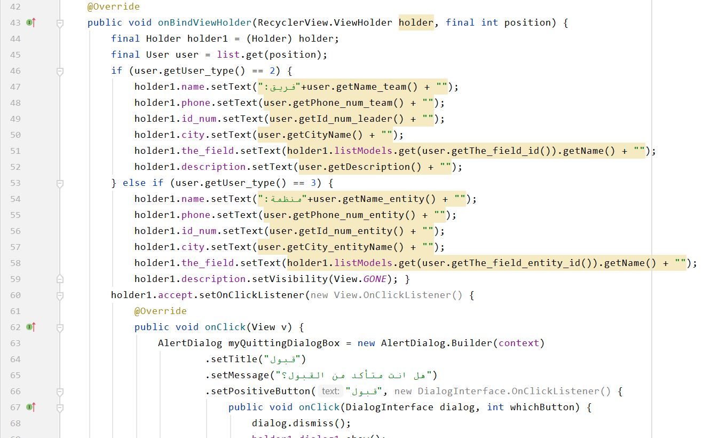
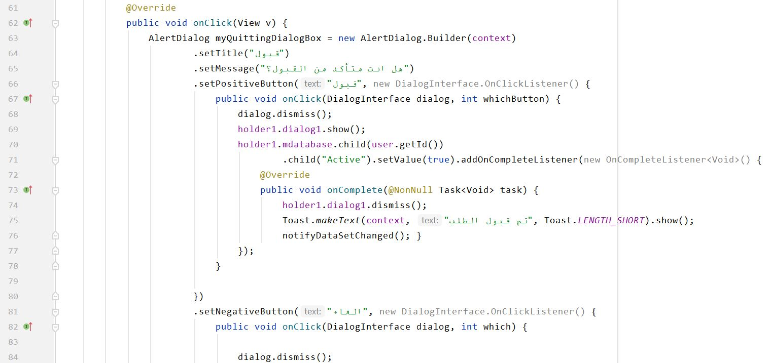
Accept or reject registration of organizations and volunteer teams
Main code
10

Slide 12

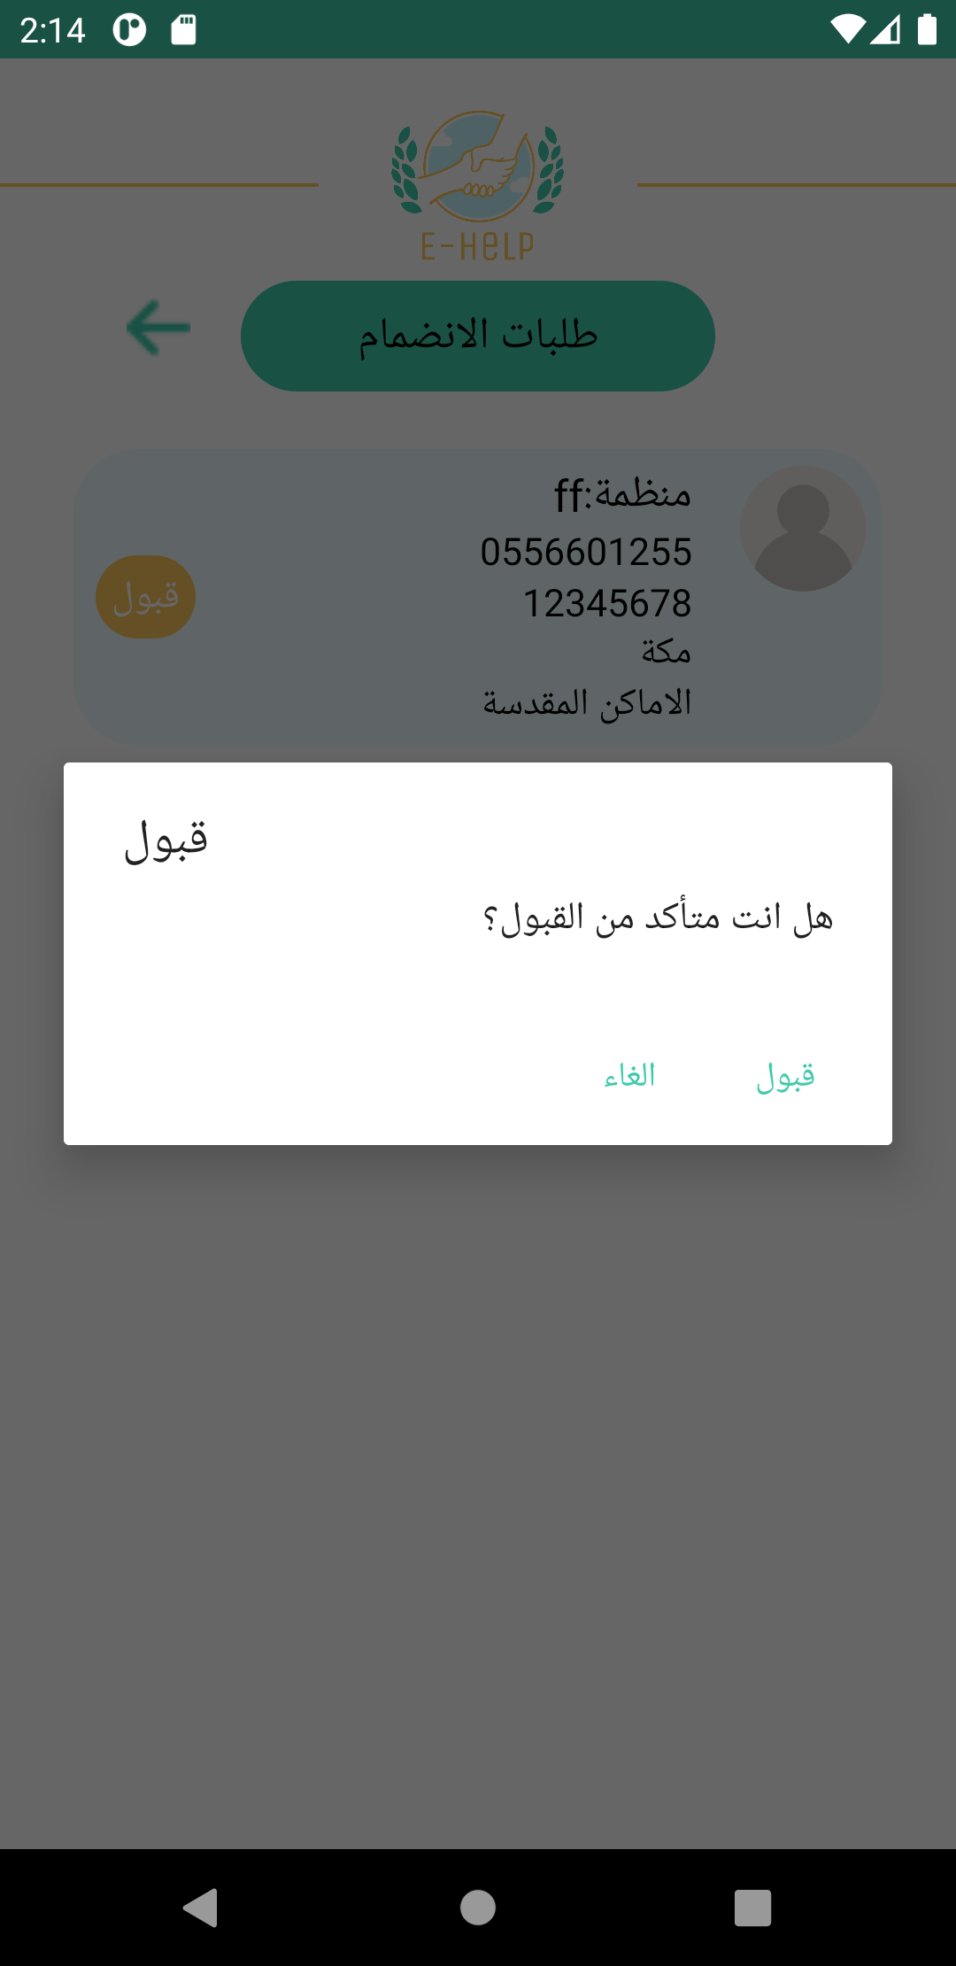
User Interface
Main code
Accept or reject registration of organizations and volunteer teams
11

Slide 13
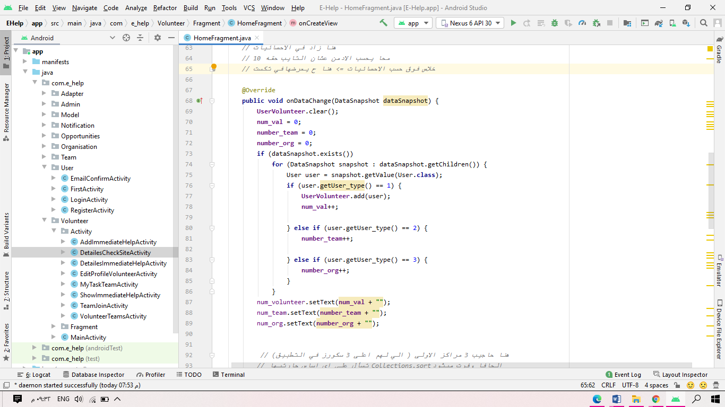
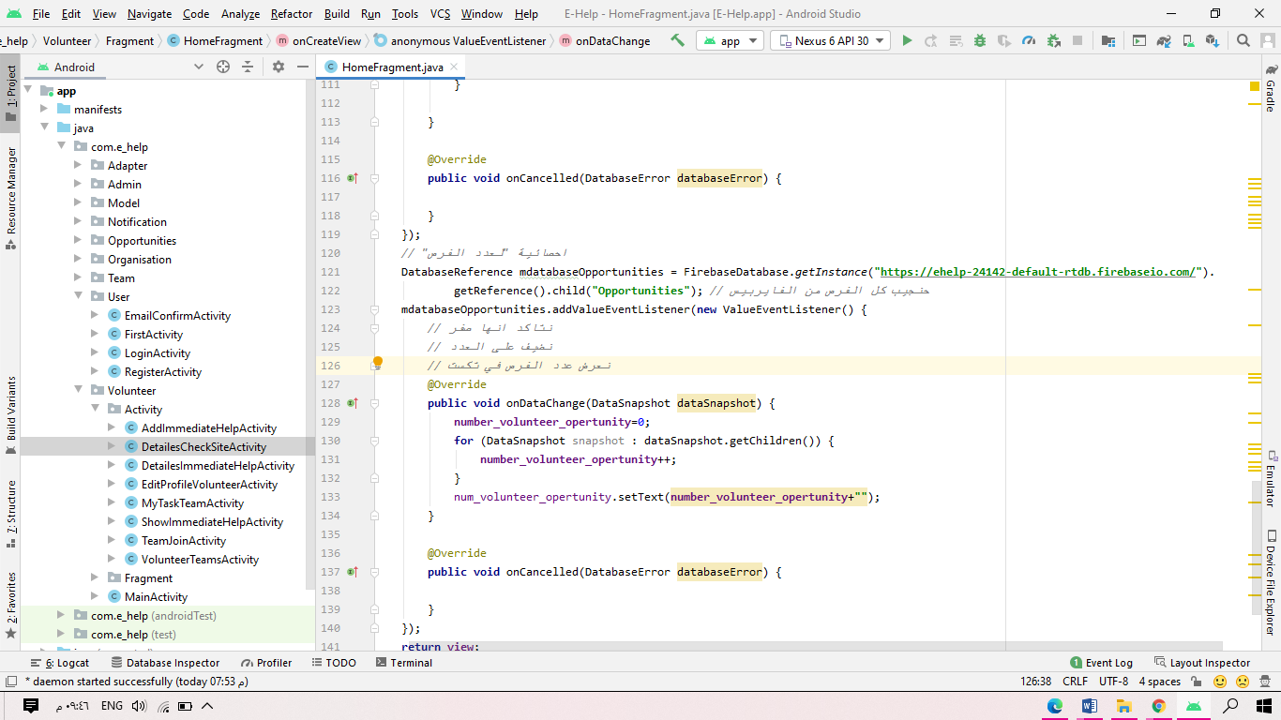
Statistics at the home page
Main code
12

Slide 14
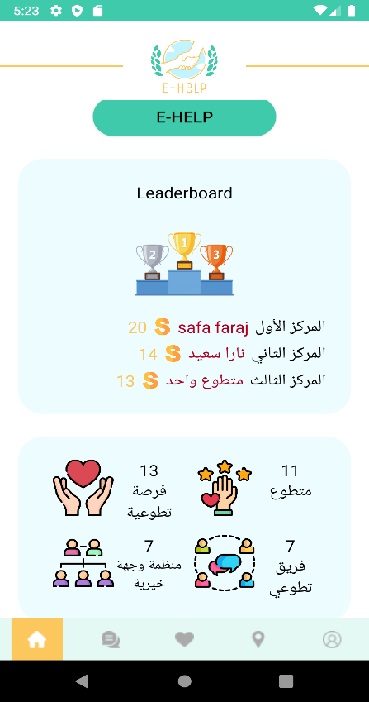
User Interface
Main code
Statistics at the home page
13

Slide 15
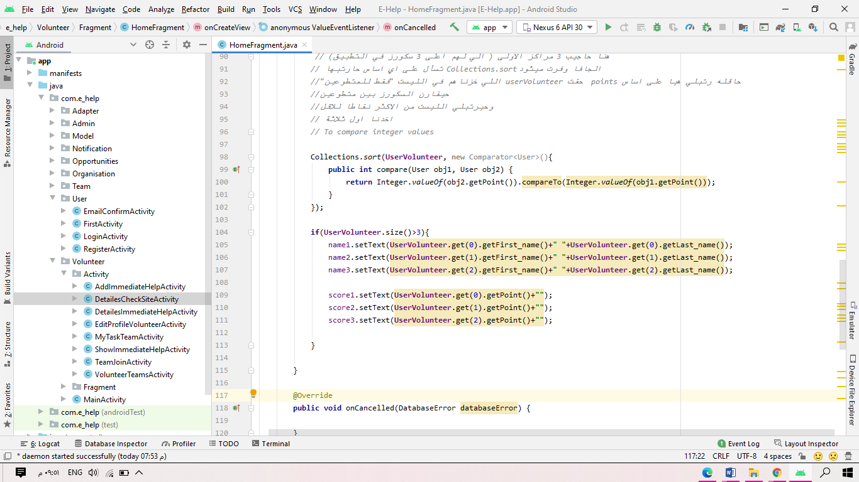
Leader Board at the home page
Main code
14

Slide 16
User Interface
Main code
Leader Board at the home page
15

Slide 17
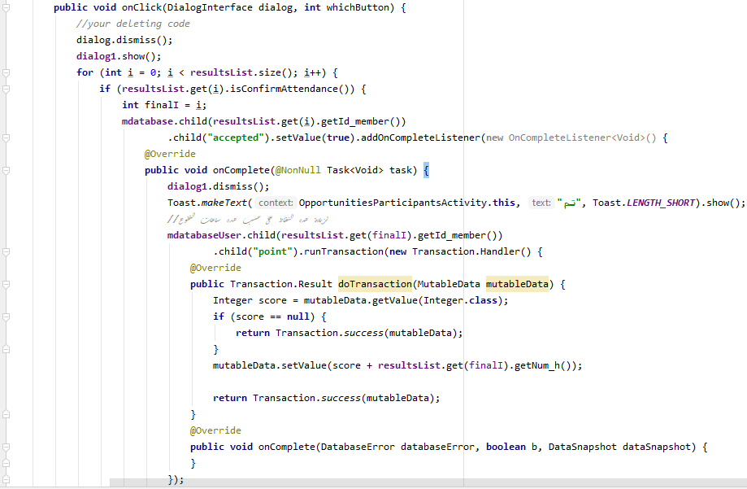
the Score
Main code
16

Slide 18
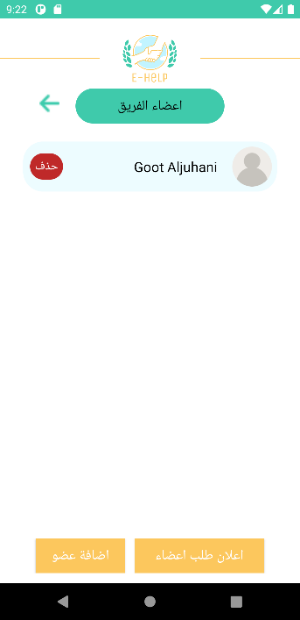
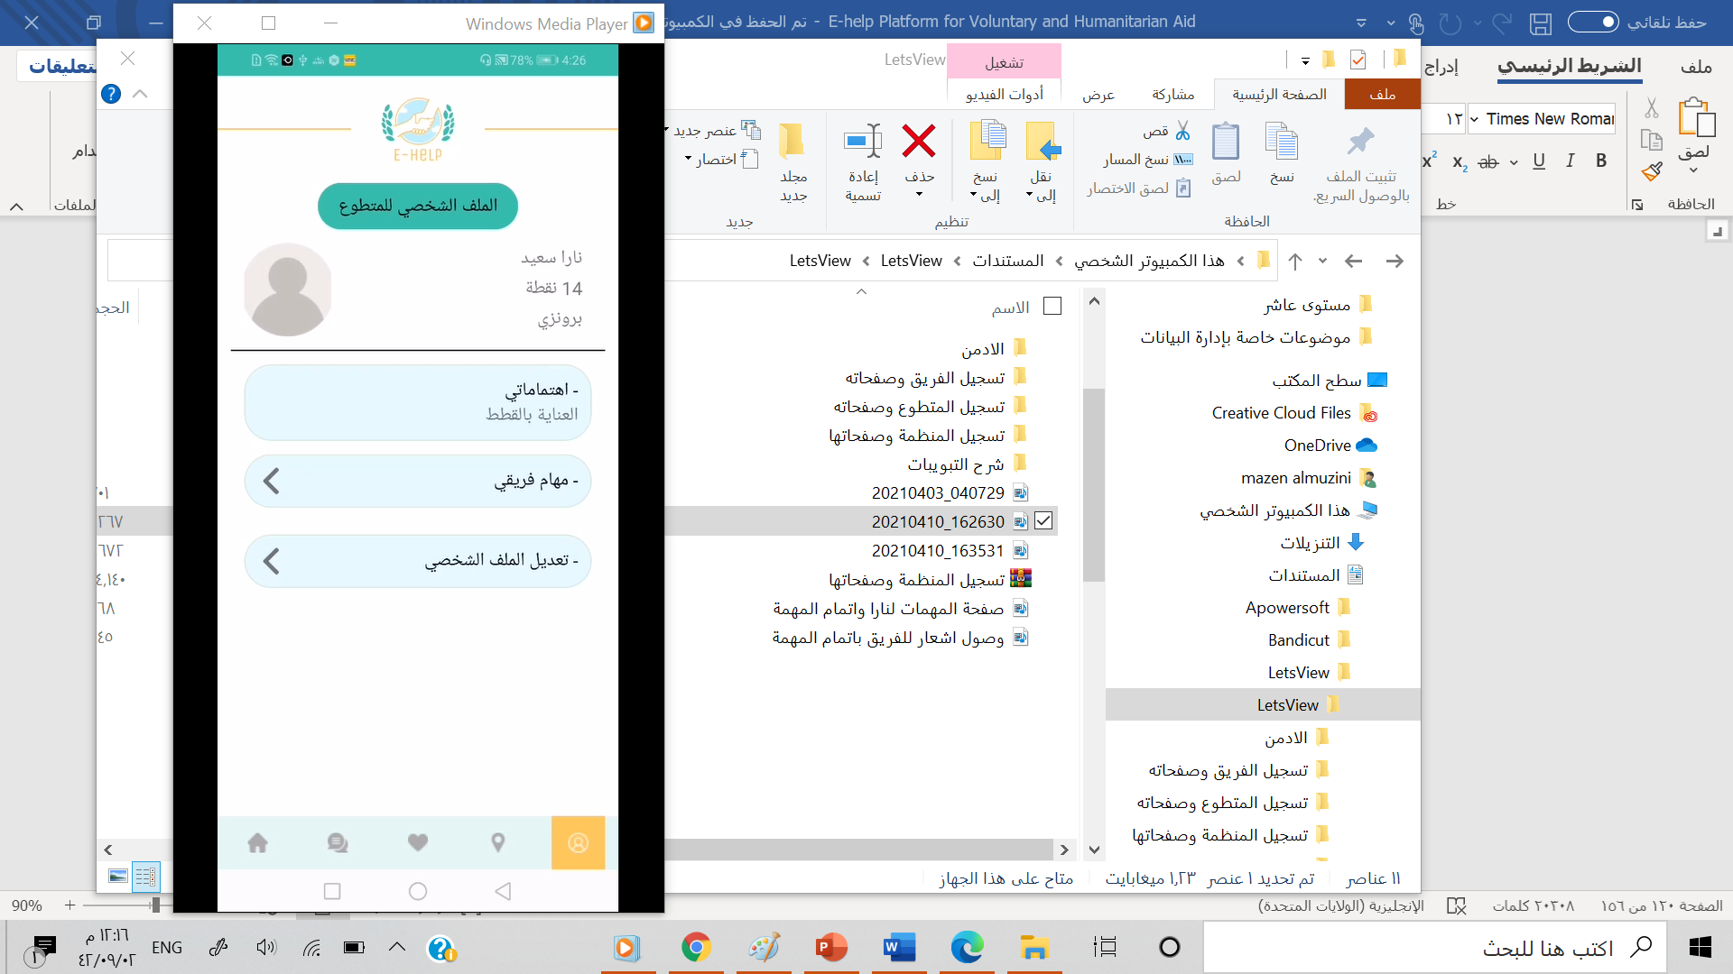
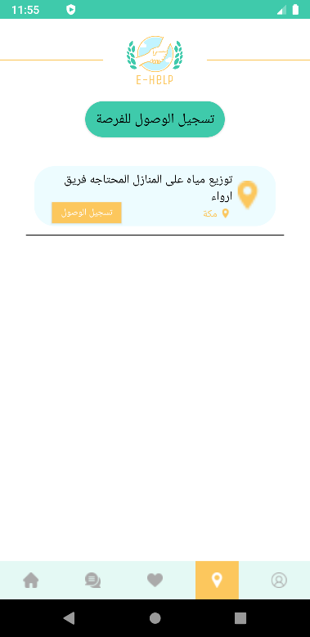
User Interface
Main code
Score at volunteer profile.
17

Slide 19
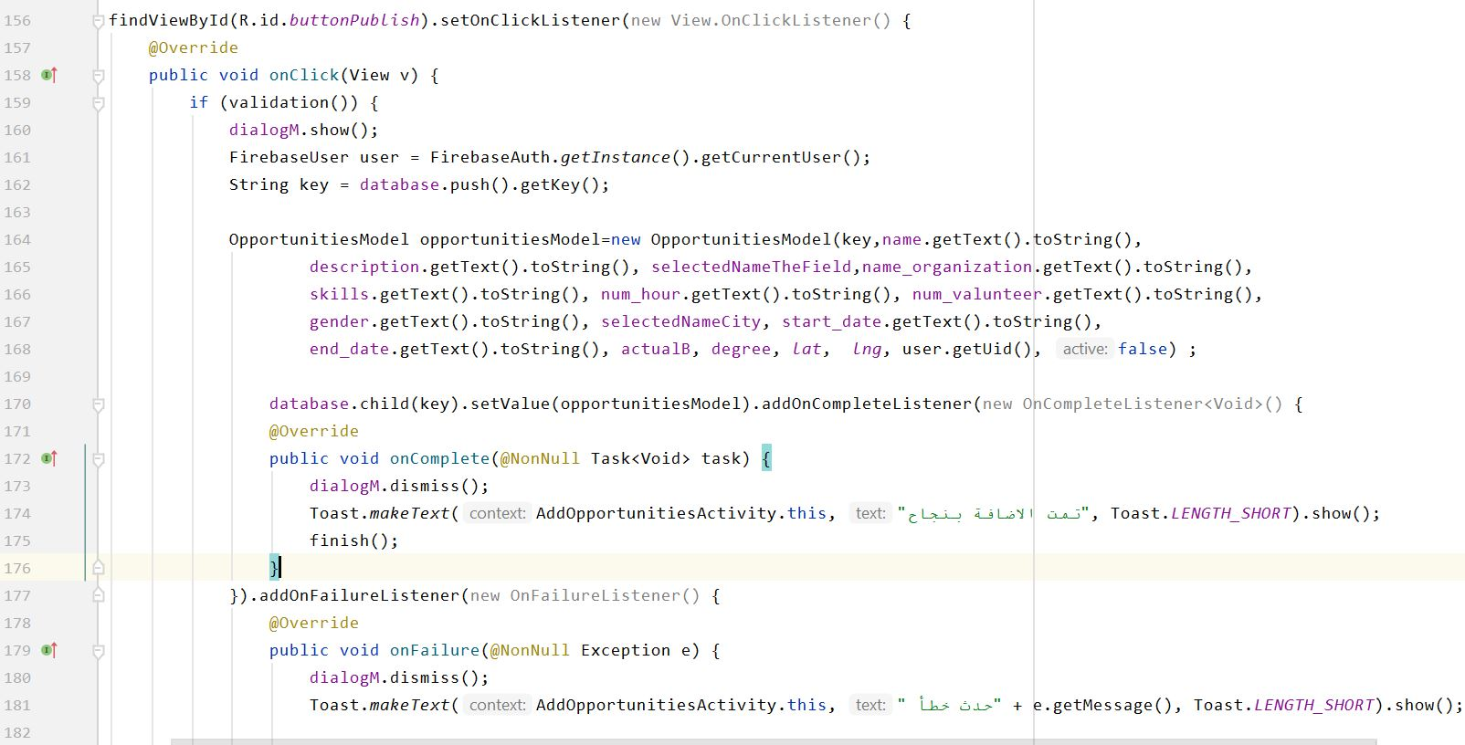
Add a new volunteering opportunity
Main code
18

Slide 20
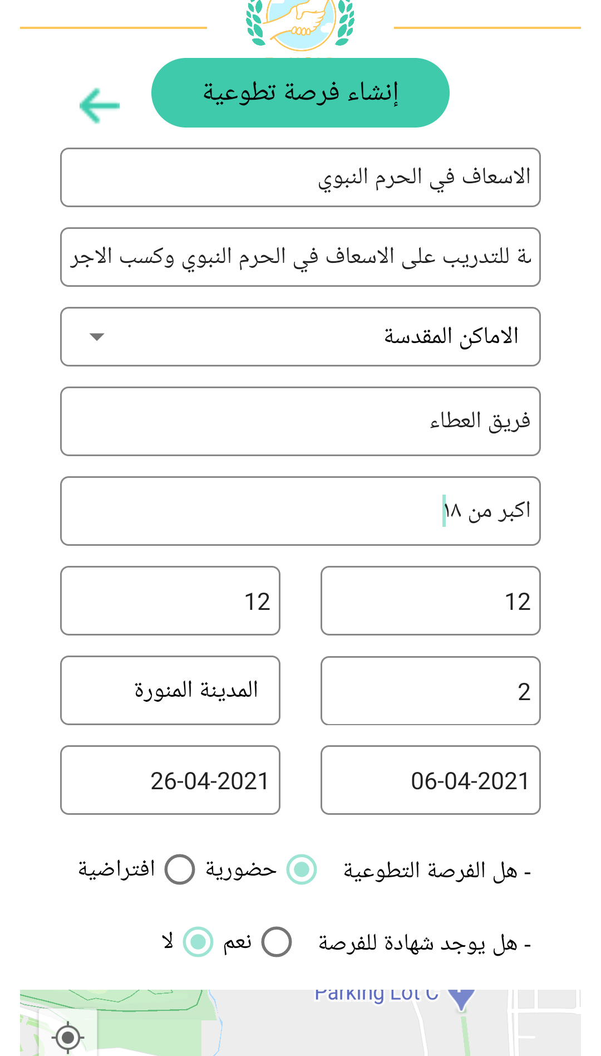
User Interface
Main code
Add a new volunteering opportunity
19

Slide 21
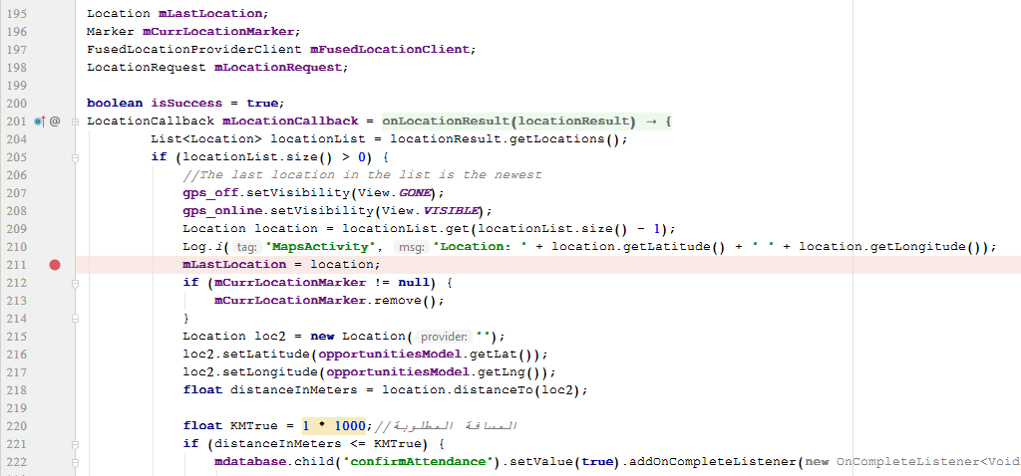
Use Check-in
Main code
20

Slide 22
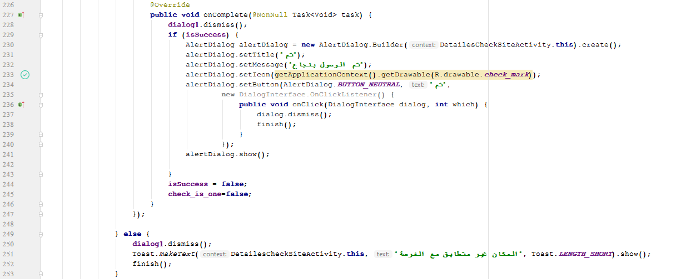
Use Check-in
Main code
21

Slide 23
User Interface
Main code
Use Check-in
22

Slide 24
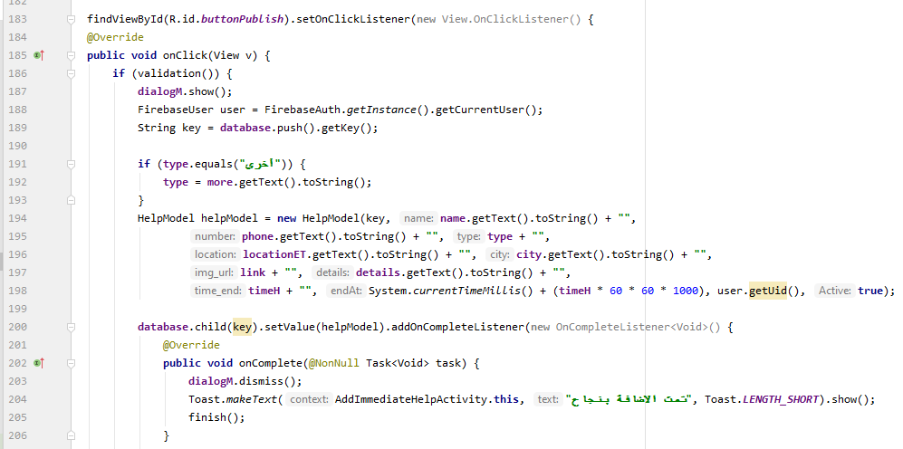
Request immediate assistance
Main code
23

Slide 25
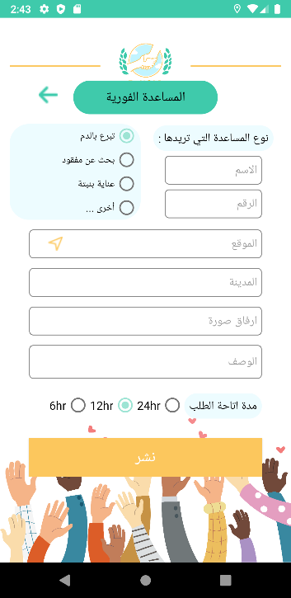
User Interface
Main code
Request immediate assistance
24

Slide 26
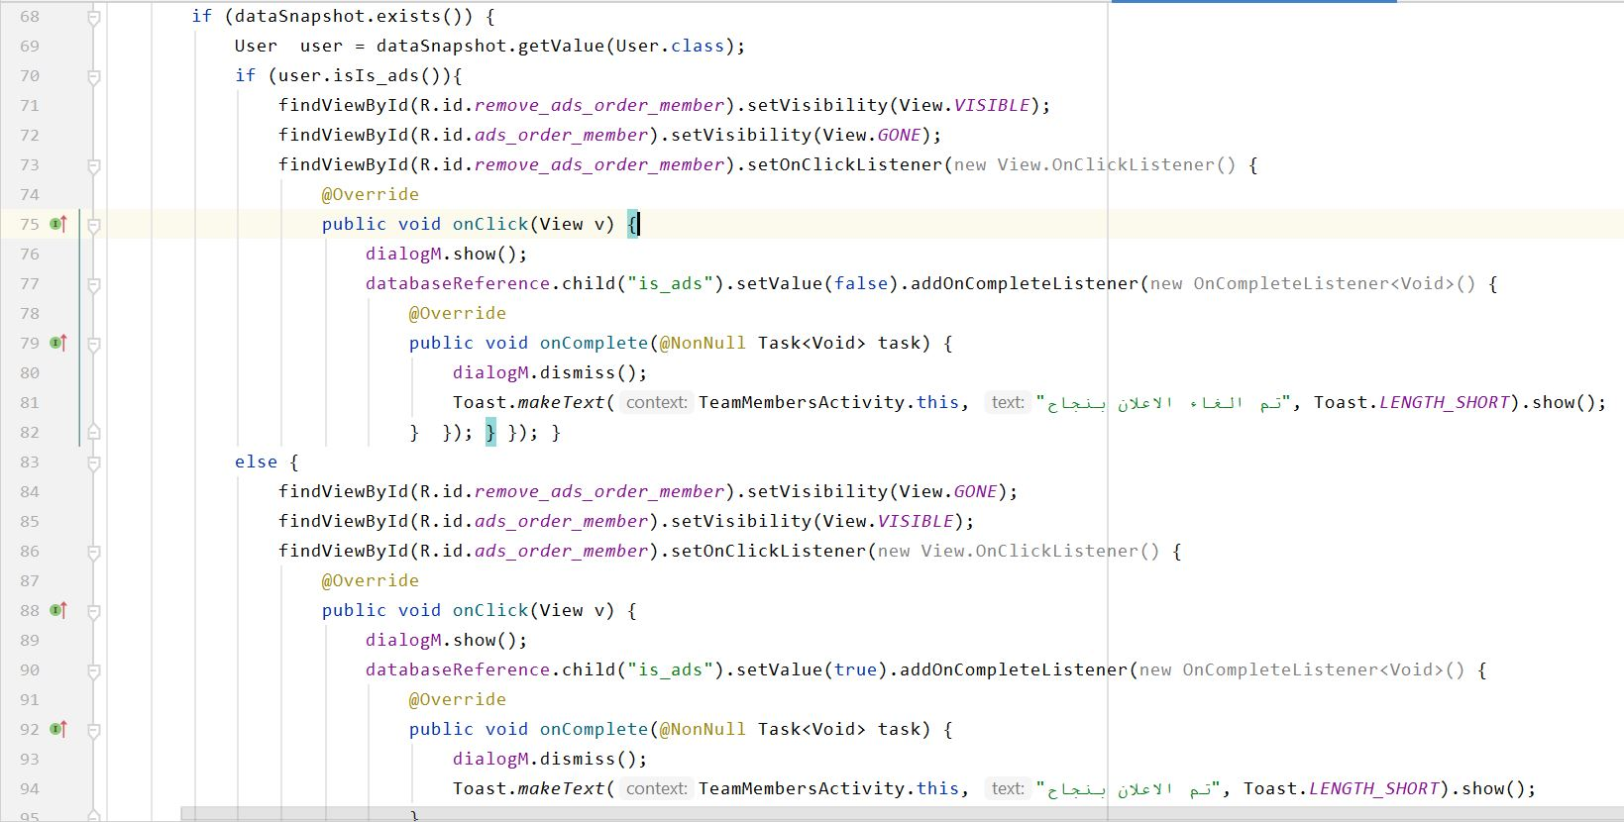
Post an advertisement requesting new members
Main code
25

Slide 27
User Interface
Main code
Post an advertisement.
26

Slide 28
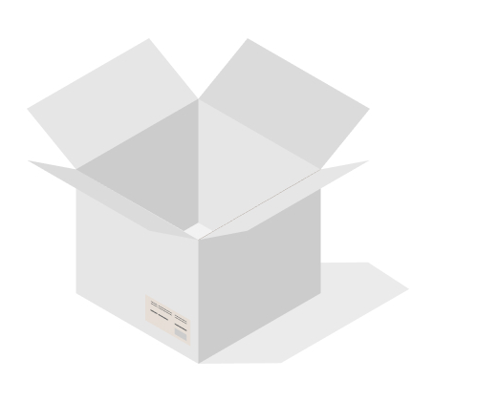
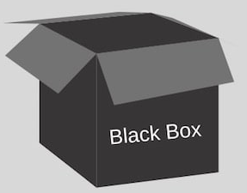

System Testing
System Testing
Integration
Testing
White-box
Testing
identifying integration issues between the modules.
The application is rigorously tested to detect and eliminate all functional defects.
Black-box
Testing
The best way to find errors and vulnerabilities .
Testing started early.
Comprehensive application test.
Does not require to know programming languages.
Test is performed from a user’s point-of-view.
27

Slide 29

Non-Functional Requirement
Result and Discussion
The survey result of organizations and teams
Agreed that the application helps volunteer teams and organizations to spread volunteer opportunities more easily.
See that the application covers all the needs of volunteer teams and organizations.
Agreed that the process of navigating between pages is easy and clear.
28

Slide 30
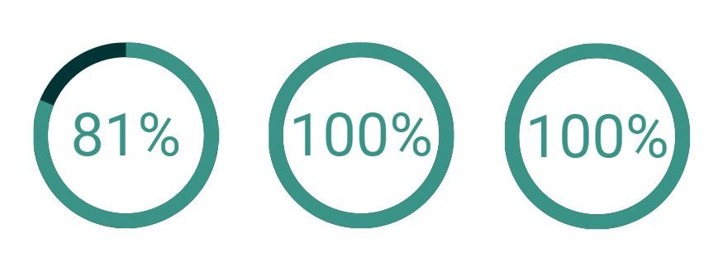
Non-Functional Requirement
Result and Discussion
The survey result of individuals
Agreed that the application includes everything the volunteer needs.
See that the application facilitates the process of volunteering and communication.
Recommend E-help application to volunteers.
29

Slide 31

Achieved Functional Requirements
Admin
Volunteer
Result and Discussion
View volunteering opportunities
Register
Edit profile
Register in a volunteering opportunity
Check-in
Be a member of volunteering team
Use Immediate Assistance
View volunteering opportunities
Accept or reject of organizations account
Accept or reject of volunteering opportunities.
30

Slide 32
Achieved Functional Requirements
Team Leader
Orgnization
Result and Discussion
View volunteering opportunities
Register
Edit profile
Add / delete member
Accept / reject joining requests
Add mission and volunteering opportunities
Use Immediate Assistance
Confirm Check-in
View volunteering opportunities
Register
Edit profile
Add volunteering opportunities
Use Immediate Assistance
Confirm Check-in
31

Slide 33
Non-functional requirements
Result and Discussion
Authentication
Extensibility
Usability
01
02
03
04
05
06
Availability
Integration
Maintenance
32

Slide 34
Conclusion
— Conclusion
The E-help application for voluntary and humanitarian aid was created and developed for all persons, organizations and teams wishing to spread volunteer opportunities.
33

Slide 35
Future Work
Future Work
Serving many voluntary organizations and teams for all regions of the Kingdom of Saudi Arabia
Create a Reminder to remind the volunteer of the volunteer opportunities they participates in
Publish the application to be available to all users
Enabling volunteer organizations and teams to issue certificates to volunteers
Issuing a report from the application to document the volunteer hours
34

Slide 36
Thank You for Listening
Any Questions?

